Slide 1

Pacific Rim International University
- Fostering Globally-leading Researchers in Integrated Sciences -
PRAGMA Joint Presentation at SC08, Austin, Texas, USA
Wednesday 19 November
Susumu Date
Shoji Miyanaga
Osaka University, Japan
Notes:
I would like to introduce an educational activity on-going at Osaka University.
The goal of the project is to educate and then lead young researchers to the researchers.

Slide 2
Contents
Background and motivation of PRIUS
What is PRIUS?
Approach of PRIUS
Future Direction

Slide 3


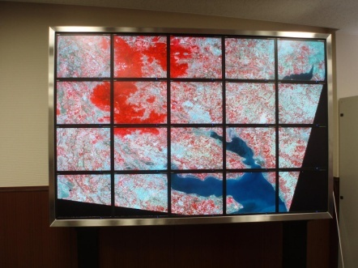
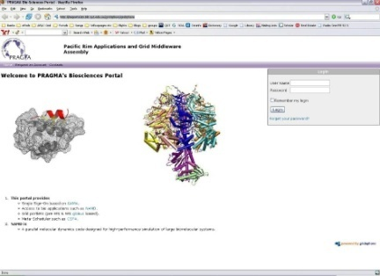
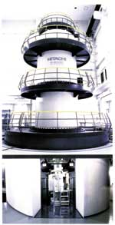
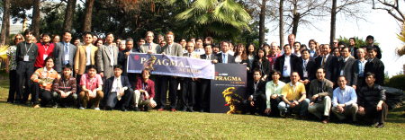
Background of PRIUS: PRAGMA
PRAGMA (Pacific Rim Applications and Grid Middleware)
  an open organization in which Pacific Rim institutions and universities will collaborate more formally to develop grid-enabled applications and will deploy the needed infrastructure throughout the Pacific Region to allow data, computing, and other resource sharing.
  Led by Dr. Peter Arzberger, UCSD
  Working groups
    Geo Science Working Group
      developing data grid technology and its application
    Bioscience Working Group
      developing grid technology useful and practical for
    biology eg. Grid portal for life science
    Telescience Working Group
    sharing scientific measurement device such as
    tiled display and high-volage microscopy
    Resource & Data Working Group
      promoting resource sharing
  URL: http://www.pragma-grid.net/
PRAGMA 14 at Taichung, Taiwan
Notes:
2回開催される。

Slide 4
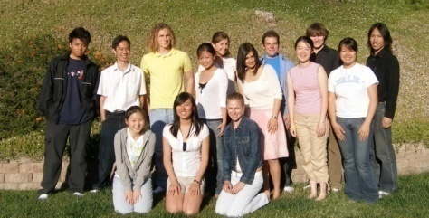
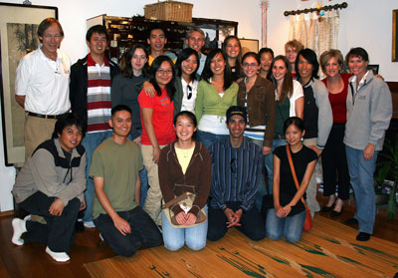
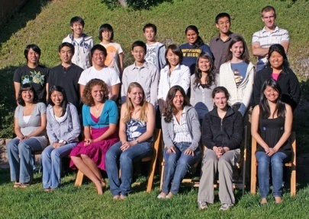
Background of PRIUS: PRIME
Pacific Rim Experiences for Undergraduates
  Started at University of California, San Diego, in 2004
  An educational project which provides an international research and cultural experience to better prepare students for the global workplace of the 21st century
  Undergraduate students are supposed to engage in the research and development work set in advance by mentors in UCSD and the host institution.
    Through the collaboration with researchers, scientists, and students in institutions and universities in the Pacific Rim (PRAGMA members), students are expected to learn the importance of international collaboration for their future.
  Until today, the following institutions have received 50+ students from UCSD.
  Australia: Monash University
  China: CNIC, CAS
  Taiwan: National Center for High-Performance
  Computing (NCHC)
  New Zealand: U. of Auckland, U. of Waikato
  Malaysia: Universiti Saint Malaysia (USM)
  Japan: Osaka University
  URL: http://www.pragma-grid.net/

Slide 5
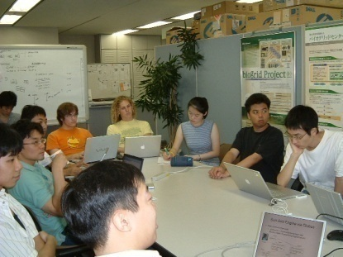
Background of PRIUS
The Graduate school of Information Science and Technology and the Cybermedia Center, Osaka University, have been collaborating in R&D activities for a long time through PRAGMA community.
  PRAGMA (Pacific Rim Applications and Grid Middleware Assembly)
  has been promoted since 2002.
  Researchers and scientists in pacific rim countries have engaged
  in R&D activities under the leadership of UCSD.
Also, Osaka University has been playing an important role in PRIME, an educational program for undergraduate students in UCSD.
  PRIME allows UCSD students to stay in host countries
  for about three months for skill building and cultural experience.
  Osaka University has accepted ten students since 2004.
Notes:
For these acivities

Slide 6



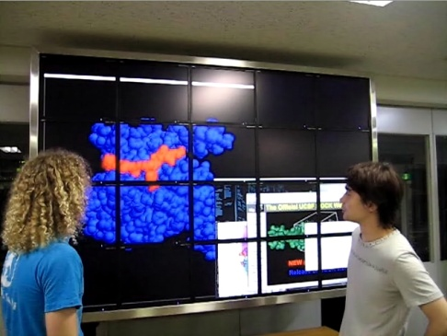
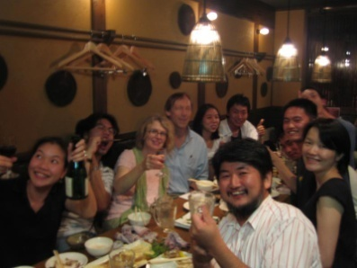
Background of PRIUS
PRAGMA community thriving
  Accumulation of expertise and practice of building highly advanced Grid applications and middleware
  Formation of human network of researchers and scientists in PacificRim
Educational becoming successful
  PRIME: Providing UCSD students with an opportunity of experiencing, studying, and learning highly sophisticated technology and cultural background through practical R&D with PRAGMA partners.
PRAGMA Brochure
Maturity of PRAGMA R&D network
Stimulating the movement toward
the establishment of PRAGMA educational network
Notes:
As we have seen so far, ….

Slide 7
What is PRIUS?
An educational project selected for the University Education Internationalization Promotion Program promoted by the Ministry of Education, Culture, Sports, Science and Technology
  Expected to improve international compatibility and commonality, as well as enhance the international competitive power, in Japan’s advanced education.
Only 15 of total 104 proposed projects have been accepted in 2005.
  As to national universities, only 9 universities started their own projects in the year
Mission: Fostering globally-leading researchers in integrated sciences
  The project is expected to be a 4-year project from 2005.
Notes:
Let me introduce our PRIUS program, which is short for Pacific Rim International University.
Our program is basically the program for educating and nurturing human resources through having

Slide 8
Goals of PRIUS
Taking advantage of both R&D and educational networks of the PRAGMA framework, PRIUS aims to establish a consistent educational infrastructure that provides graduate students with the opportunities to broaden their international perspective.
Through the established educational infrastructure, PRIUS aims to develop researchers who have the ability to take a leadership in the globalized world.
  Language --- Most difficult!
  Cross-cultural experience
  Knowledge in cutting-edge technology as a computer engineer and scientist
  How to collaborate

Slide 9


Approach of PRIUS
Establish a consistent educational program for graduate students.
Lectures by international speakers
On-the-job-training education on PRAGMA research framework
P.D Exchange prgm: produces
liquidity in human resource
P.D
Long Abroad Internship:
Provide skill building chances
Doc
Research
Short Abroad Internship:
Offer trial opportunities
Education
M2
M1
Lecture course:
Stimulate students’ ambitious
Notes:
For the goal, we had the strategy to combine ojt and In other words,
Keeping a good balance between education and research, we

Slide 10
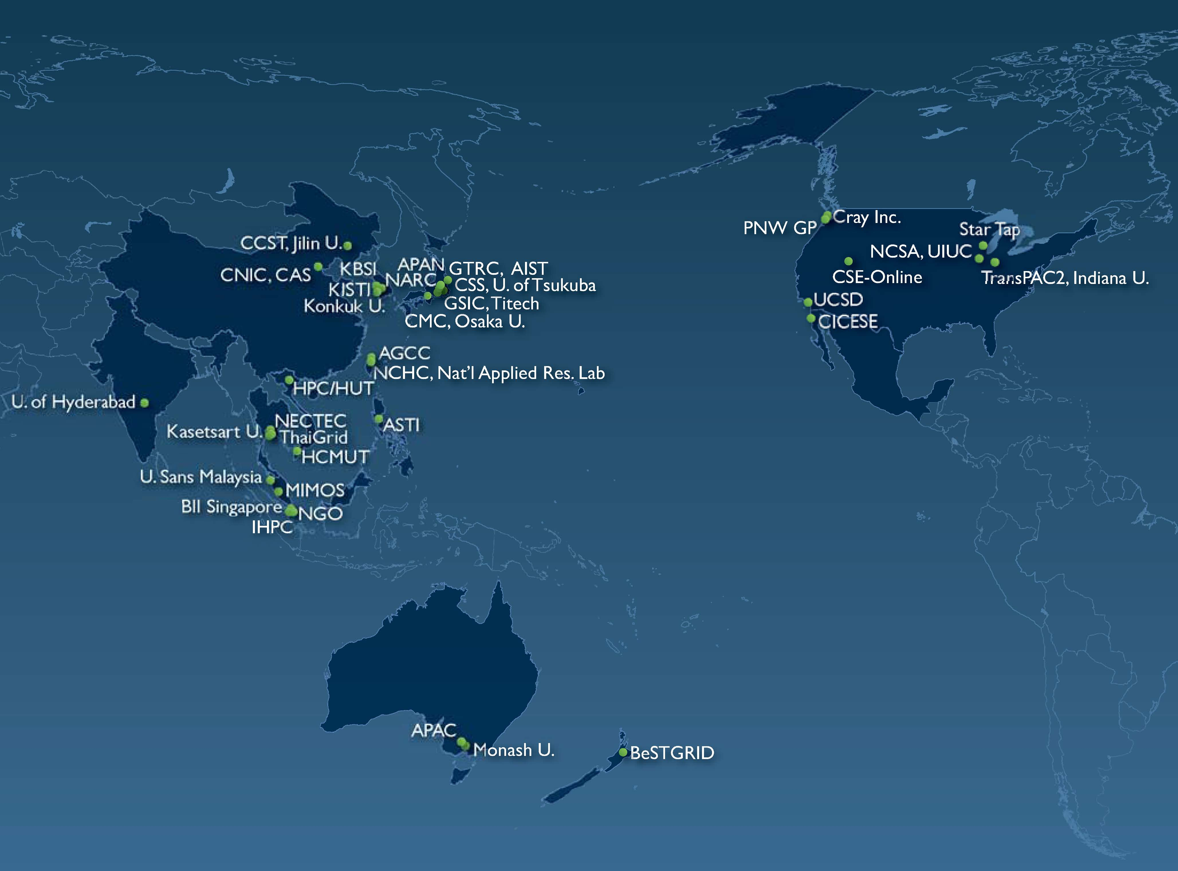
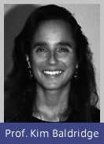

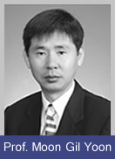


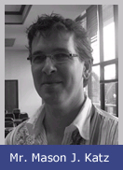

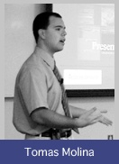
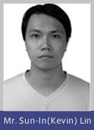
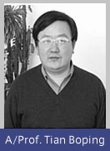
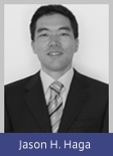
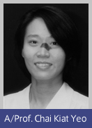
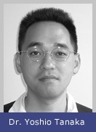
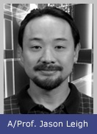
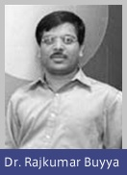

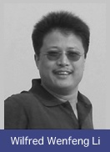
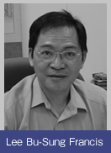
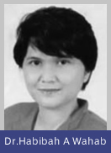




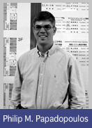
PRIUS class
Studies on International Integrated Sciences I, II
Invited Lecturers: 37 in total from 14 Institutions, 11 countries; topics ranging from the basics of computer science to applications
English-based
Cutting-edge information technologies
the importance of IT
the necessity of (international) collaboration with other fields
Notes:
Topics ranges from the basics of computer science to various applications by lecturers.
Through the classes, students are learning not only cutting-edge infomration technologies but also how to apply them to applications.
Also, how to collaborate with researchers and scientists in the international projects are learnt

Slide 11
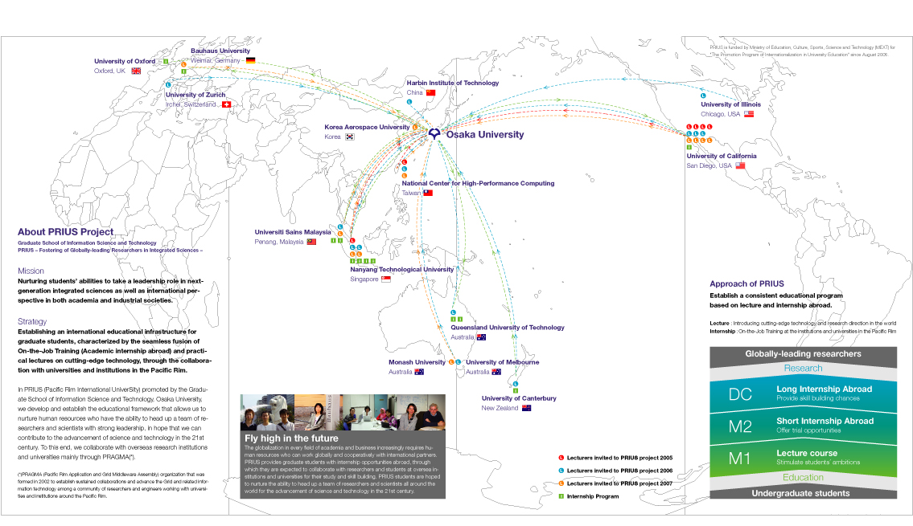
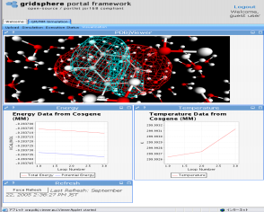

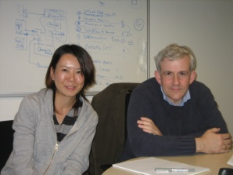


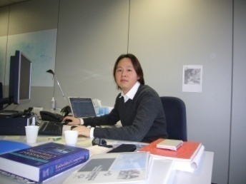

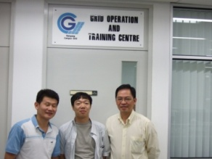


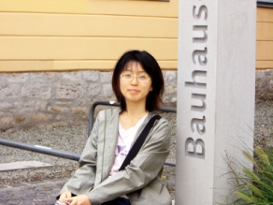
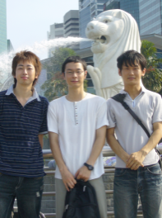
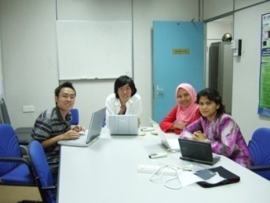


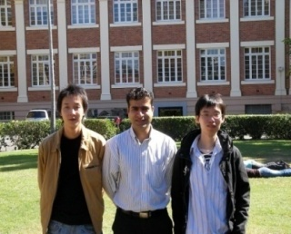
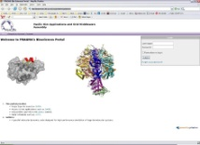


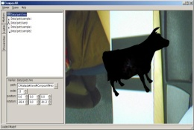
PRIUS Internship
International Education Program spanning 19 Institutes in 13 Countries
Visiting Lecturers
FY2005 6 researchers
FY2006 13 researchers
FY2007 12 researchers
FY2008 12 researchers (scheduled)
Internship Abroad
FY2005 1 student
FY2006 4 students
FY2007 7 students
FY2008 8 students (planed)
At U. of Oxford
At IMEC Belgium
At UCSD
At Bauhaus University
At NTU, Singapore
At University of Canterbury
At USM, Malaysia
At Queensland University of Technology
Notes:
Stimulating students’ ambition and widen internationalization
Expanding the framework from the pacific rim to the world.
Some of students are trying to use the internship through the existent collaboration relationship with oversea institutions.

Slide 12
Milestones in PRIUS
Phase 1: Establishment of PRIUS, and Investigation of Issues (2005 – 2006.10)
  Sending students to UCSD experimentally to explore the possibility and issues to make a course for abroad internship
  Opening a course named “Studies on International Integrated Sciences” in Osaka University
  Establish PRIUS office
Phase 2: Expansion of PRIUS (2006.10 – 2007.10)
  Expansion of the course based on students’ demand
  Expanding the framework to other institutions in the Pacific Rim based on the experience obtained through the collaboration with PRAGMA in phase 1
Phase 3: Introduce results from the PRIUS project to the international collaborative research community (2007.10 – 2008. 3)
  Explore the possibility of credit transfer among other universities.

Slide 13


Next Step – Inter-educational Infrastructure?
PRIEST （Pacific Rim International Education for Science and Technology) ?
Monash University
MURPA (Monash Undergraduate Research Project Abroad)
PRAGMA (Pacific Rim Applications and
Grid Middleware Assembly)
University of California,
San Diego
Osaka University
PRIME (Pacific RIM
undergraduate Experience)
PRIUS (Pacific Rim International UniverSity)
Universiti Sains Malaysia
PRIUSM (PRIUS in Malaysia)

Slide 14
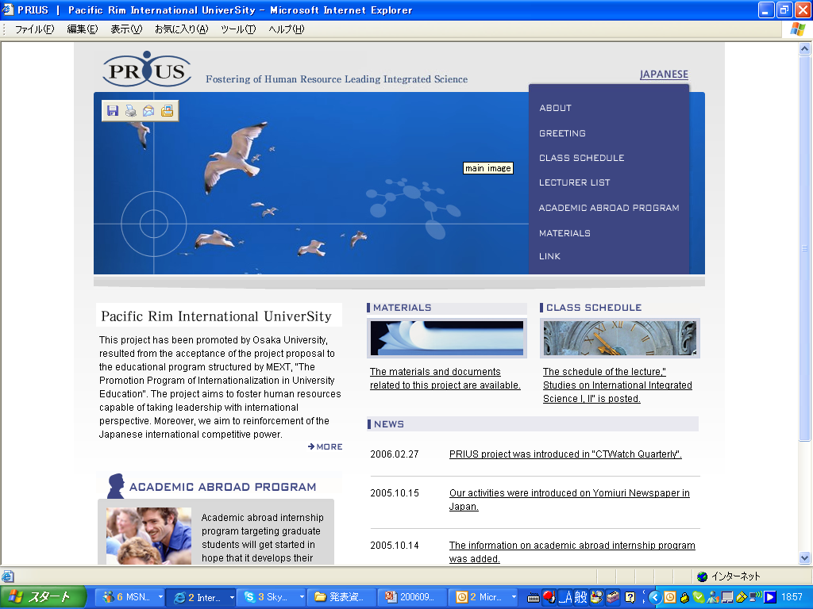
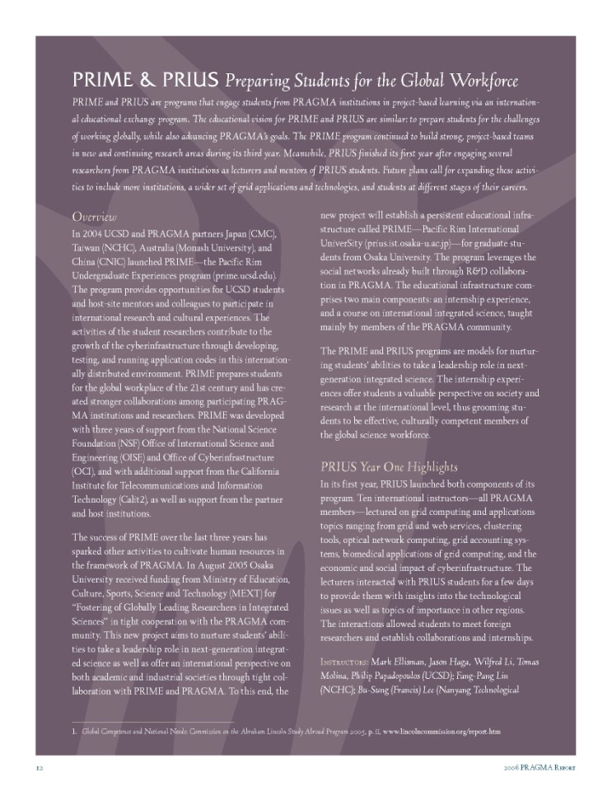
More Information
PRAGMA Brochure
For the information on PRIUS,
Project Web: http://prius.ist.osaka-u.ac.jp
For the relationship of PRIUS, PRIME, and
PRAGMA, PRAGMA 2008 Brochure
http://www.pragma-grid.net
http://prime.ucsd.edu

